Slide 1
Classification and Regression Trees
(CART)

Slide 2
Variety of approaches used
CART developed by Breiman Friedman Olsen and Stone: “Classification and Regression Trees”
C4.5 A Machine Learning Approach by Quinlan
Engineering approach by Sethi and Sarvarayudu

Slide 3
Example
University of California- a study into patients after admission for a heart attack
19 variables collected during the first 24 hours for 215 patients (for those who survived the 24 hours)
Question: Can the high risk (will not survive 30 days) patients be identified?

Slide 4
Answer
Is the minimum systolic blood pressure over the !st 24 hours>91?
Is age>62.5?
H
Is sinus tachycardia present?
L
H
L

Slide 5
Features of CART
Binary Splits
Splits based only on one variable

Slide 6
Plan for Construction of a Tree
Selection of the Splits
Decisions when to decide that a node is a terminal node (i.e. not to split it any further)
Assigning a class to each terminal node

Slide 7
Impurity of a Node
Need a measure of impurity of a node to help decide on how to split a node, or which node to split
The measure should be at a maximum when a node is equally divided amongst all classes
The impurity should be zero if the node is all one class

Slide 8
Measures of Impurity
Misclassification Rate
Information, or Entropy
Gini Index
In practice the first is not used for the following reasons:
Situations can occur where no split improves the misclassification rate
The misclassification rate can be equal when one option is clearly better for the next step

Slide 9
Problems with Misclassification Rate I
40 of A | 60 of A
60 of A | 40 of B
Possible split
Possible split
Neither improves misclassification rate, but together give perfect classification!

Slide 10
Problems with Misclassification Rate II
400 of A 400 of B
OR?
400 of A
400 of B
300 of A
100 of B
100 of A
300 of B
200 of A
400 of B
200 of A
0 of B

Slide 11
Misclassification rate for two classes
1/2
0.5
0
p₁
1

Slide 12
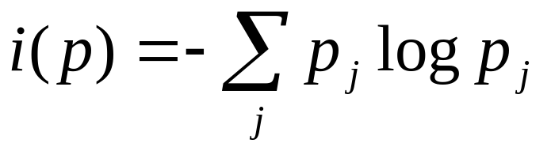
Information
If a node has a proportion of p_{j} of each of the classes then the information or entropy is:
where 0log0 = 0
Note: p=(p₁,p₂,…. p_{n})

Slide 13
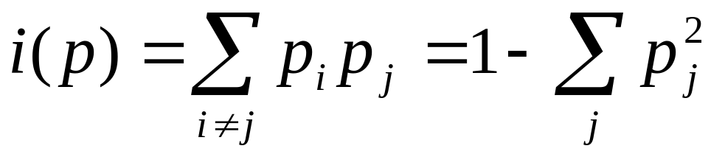
Gini Index
This is the most widely used measure of impurity (at least by CART)
Gini index is:

Slide 14
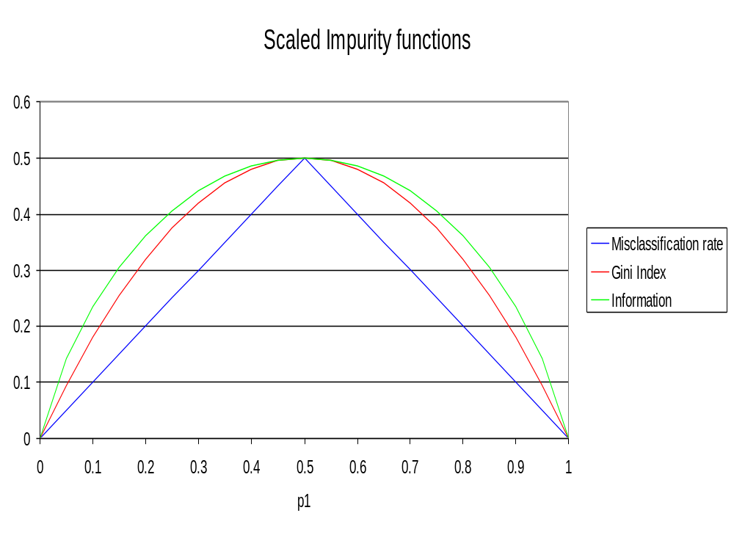

Slide 15
Tree Impurity
We define the impurity of a tree to be the sum over all terminal nodes of the impurity of a node multiplied by the proportion of cases that reach that node of the tree
Example i) Impurity of a tree with one single node, with both A and B having 400 cases, using the Gini Index:
Proportions of the two cases= 0.5
Therefore Gini Index= 1-(0.5)²- (0.5)² = 0.5

Slide 16
Tree Impurity Calculations
Numbers of Cases |  | Proportion of Cases |  |  |  | Gini Index
A | B | A | B
 |  | p_{A} | p_{B} | p²_{A} | p²_{B} | 1- p²_{A}- p²_{B}
400 | 400 | 0.5 | 0.5 | 0.25 | 0.25 | 0.5

Slide 17
Number of Cases |  | Proportion of Cases |  |  |  | Gini Index | Contrib. To Tree
A | B | A | B
 |  | p_{A} | p_{B} | p²_{A} | p²_{B} | 1- p²_{A} - p²_{B}
300 | 100 | 0.75 | 0.25 | 0.5625 | 0.0625 | 0.375 | 0.1875
100 | 300 | 0.25 | 0.75 | 0.0625 | 0.5625 | 0.375 | 0.1875
 |  |  |  |  |  | Total | 0.375
200 | 400 | 0.33 | 0.67 | 0.1111 | 0.4444 | 0.4444 | 0.3333
200 | 0 | 1 | 0 | 1 | 0 | 0 | 0
 |  |  |  |  |  | Total | 0.3333

Slide 18
Selection of Splits
We select the split that most decreases the Gini Index. This is done over all possible places for a split and all possible variables to split.
We keep splitting until the terminal nodes have very few cases or are all pure – this is an unsatisfactory answer to when to stop growing the tree, but it was realized that the best approach is to grow a larger tree than required and then to prune it!

Slide 19
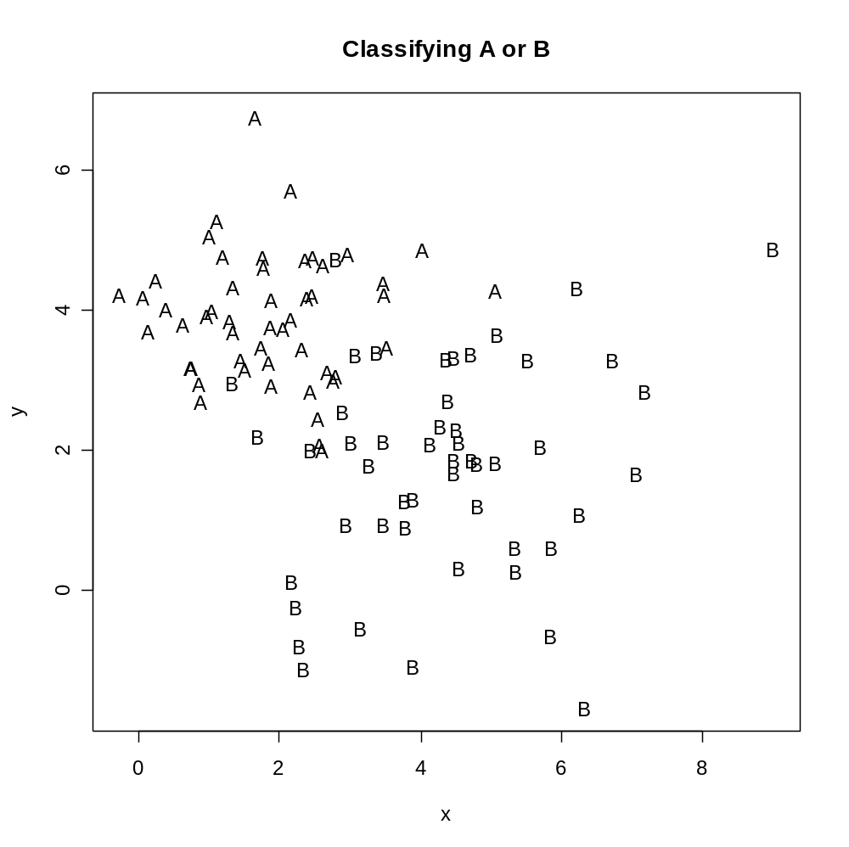
Example – The same one used for Nearest Neighbour classification

Slide 20
Possible Splits
There are two possible variables to split on and each of those can split for a range of values of c i.e.:
x<c or x≥c
And:
y<c or y≥c

Slide 21
 |  |  | Split= | 2.81
x | y | Class | A | B | A | B
2.61 | 2.02 | A | 1 | 0 | 0 | 0
2.57 | 2.10 | A | 1 | 0 | 0 | 0
2.85 | 2.46 | B | 0 | 0 | 0 | 1
2.45 | 2.85 | A | 1 | 0 | 0 | 0
2.76 | 3.00 | A | 1 | 0 | 0 | 0
2.82 | 3.07 | A | 0 | 0 | 1 | 0
2.68 | 3.13 | B | 0 | 1 | 0 | 0
Etc.

Slide 22
Top | 50 | 50 | 100 | 0.5 | 0.5 | 0.25 | 0.25 | 0.5
Split Left | 44 | 7 | 51 | 0.86 | 0.14 | 0.74 | 0.02 | 0.24 | 0.12
Split Right | 6 | 43 | 49 | 0.12 | 0.88 | 0.01 | 0.77 | 0.21 | 0.11
 |  |  |  |  |  |  |  | Sum= | 0.23
 |  |  |  |  |  |  |  | Change in | 0.27
 |  |  |  |  |  |  |  | Gini Index

Slide 23
Split | Change
 | 0.27
1.5 | 0.10
1.6 | 0.11
1.7 | 0.12
1.8 | 0.13
1.9 | 0.16
2 | 0.16
2.1 | 0.17
2.2 | 0.17
2.3 | 0.15
Then use Data table to find the best value for a split.

Slide 24
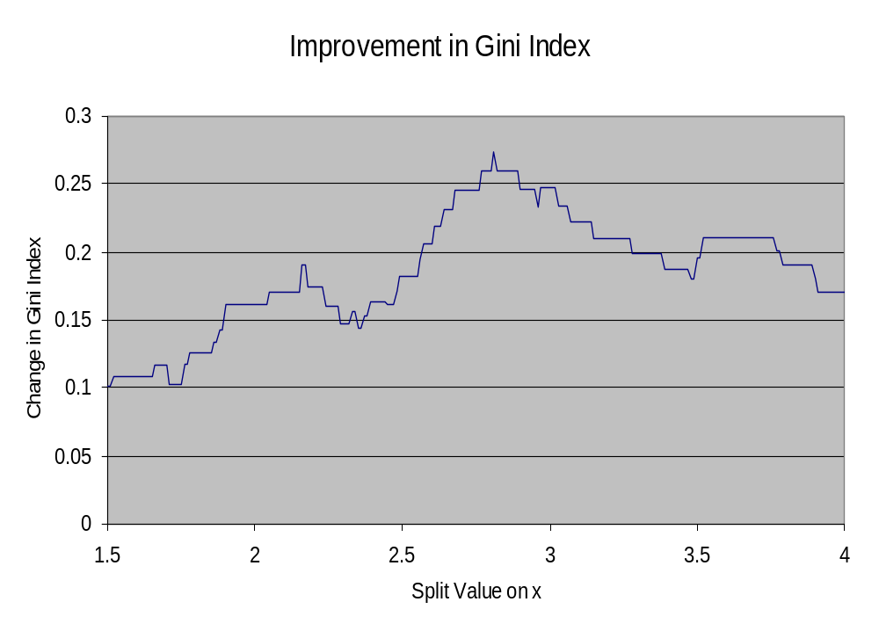

Slide 25
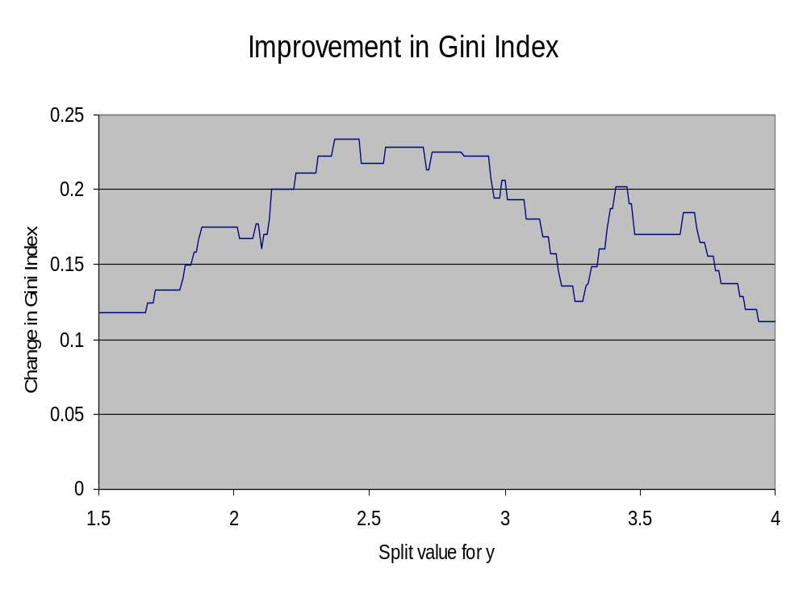

Slide 26
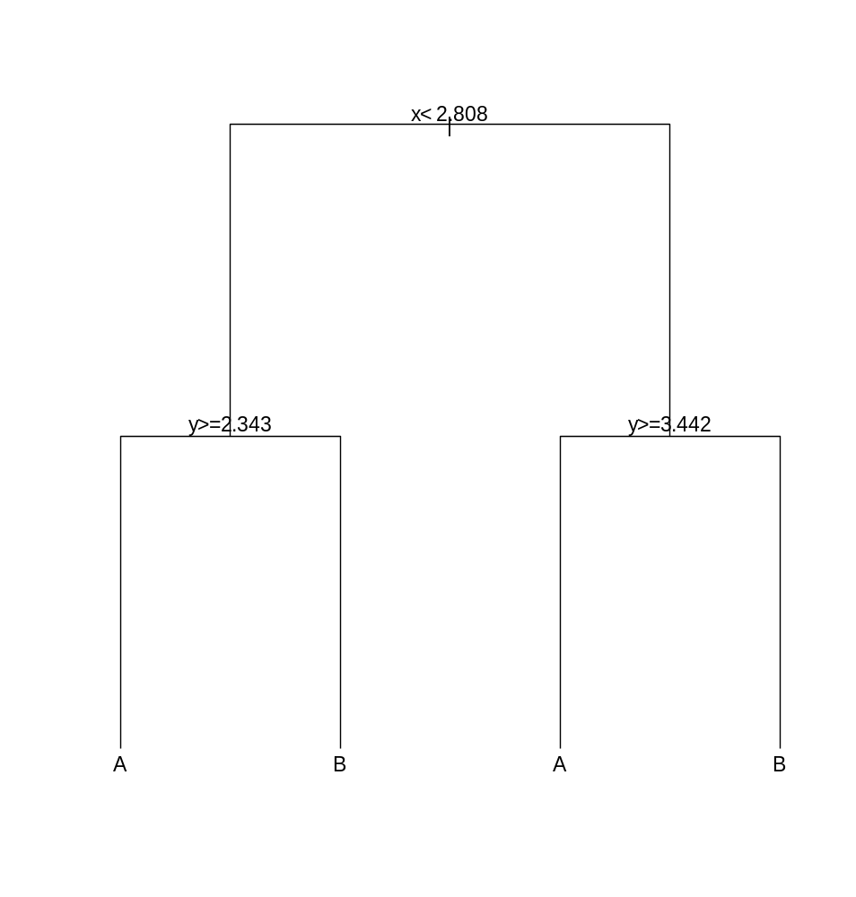
The Next Step
You’d now need to develop a series of spreadsheets to work out the next best split
This is easier in R!

Slide 27
Developing Trees using R
Need to load the package “rpart” which contains the set of functions for CART
The function looks like:
NNB.tree<-rpart(Type~., NNB[ , 1:2], cp = 1e-3)
This takes the data in Type (which contains the classes for the data, i.e. A or B), and builds a model on all the variables indicated by “~.” . The data is in NNB[, 1,2] and cp is complexity parameter (more to come about this).

Slide 28
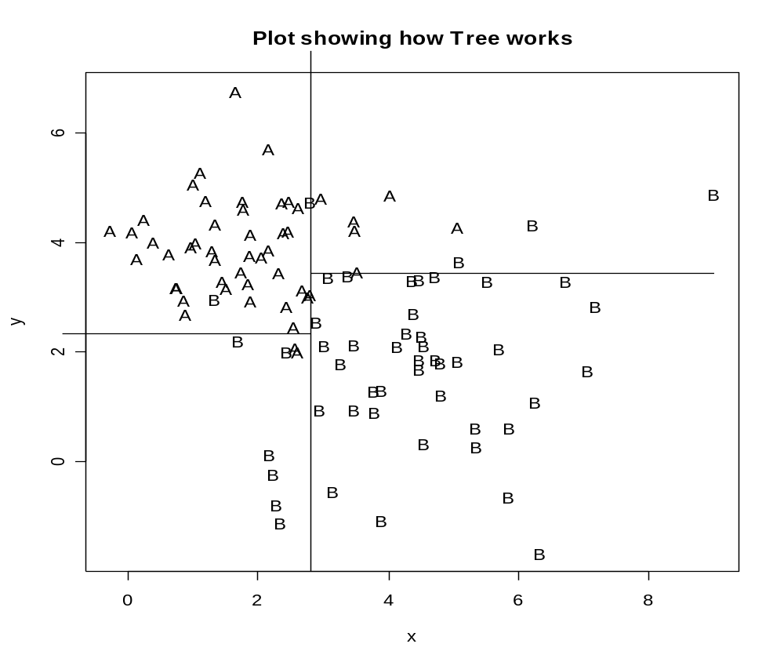

Slide 29
A More Complicated Example
This is based on my own research
Wish to tell which is best method of exponential smoothing to use based on the data automatically.
The variables used are the differences of the fits for three different methods (SES, Holt’s and Damped Holt’s Methods), and the alpha, beta and phi estimated for Damped Holt method.

Slide 30
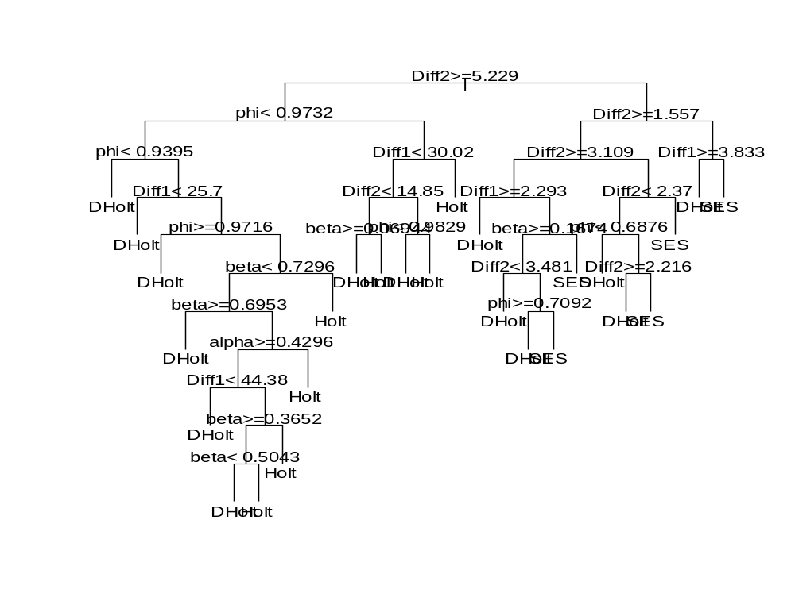
This gives a very complicated tree!

Slide 31
Pruning the Tree I
As I said earlier it has been found that the best method of arriving at a suitable size for the tree is to grow an overly complex one then to prune it back. The pruning is based on the misclassification rate. However the error rate will always drop (or at least not increase) with every split. This does not mean however that the error rate on Test data will improve.

Slide 32
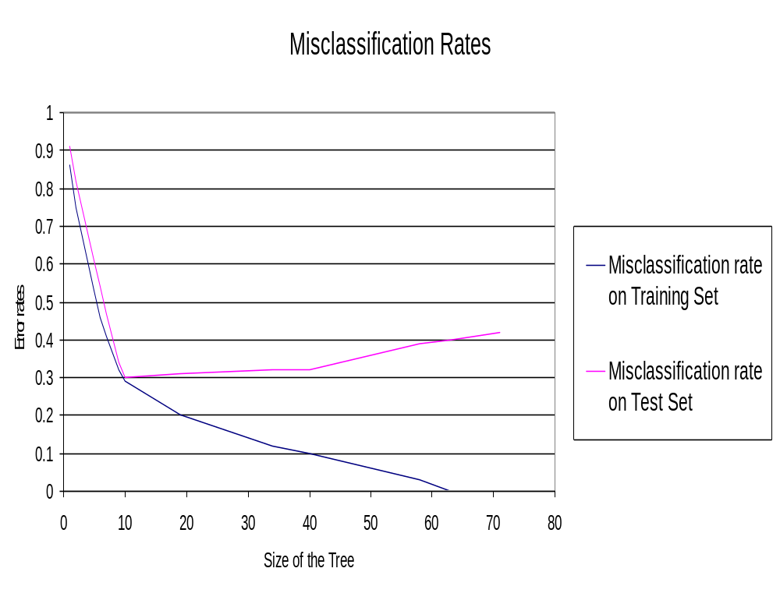
Source: CART by Breiman et al.

Slide 33
Pruning the Tree II
The solution to this problem is cross-validation. One version of the method carries out a 10 fold cross validation where the data is divided into 10 subsets of equal size (at random) and then the tree is grown leaving out one of the subsets and the performance assessed on the subset left out from growing the tree. This is done for each of the 10 sets. The average performance is then assessed.

Slide 34
Pruning the Tree III
This is all done by the command “rpart” and the results can be accessed using “printcp “ and “plotcp”.
We can then use this information to decide how complex (determined by the size of cp) the tree needs to be. The possible rules are to minimise the cross validation relative error (xerror), or to use the “1-SE rule” which uses the largest value of cp with the “xerror” within one standard deviation of the minimum. This is preferred by Breiman et al and B D Ripley who has included it as a dashed line in the “plotcp” function

Slide 35
> printcp(expsmooth.tree)
Classification tree:
rpart(formula = Model ~ Diff1 + Diff2 + alpha + beta + phi, data = expsmooth,
cp = 0.001)
Variables actually used in tree construction:
[1] alpha beta Diff1 Diff2 phi
Root node error: 2000/3000 = 0.66667
n= 3000
CP nsplit rel error xerror xstd
1 0.4790000 0 1.0000 1.0365 0.012655
2 0.2090000 1 0.5210 0.5245 0.013059
3 0.0080000 2 0.3120 0.3250 0.011282
4 0.0040000 4 0.2960 0.3050 0.011022
5 0.0035000 5 0.2920 0.3115 0.011109
6 0.0025000 8 0.2810 0.3120 0.011115
7 0.0022500 9 0.2785 0.3085 0.011069
8 0.0020000 13 0.2675 0.3105 0.011096
9 0.0017500 16 0.2615 0.3075 0.011056
10 0.0016667 20 0.2545 0.3105 0.011096
11 0.0012500 23 0.2495 0.3175 0.011187
12 0.0010000 25 0.2470 0.3195 0.011213

Slide 36
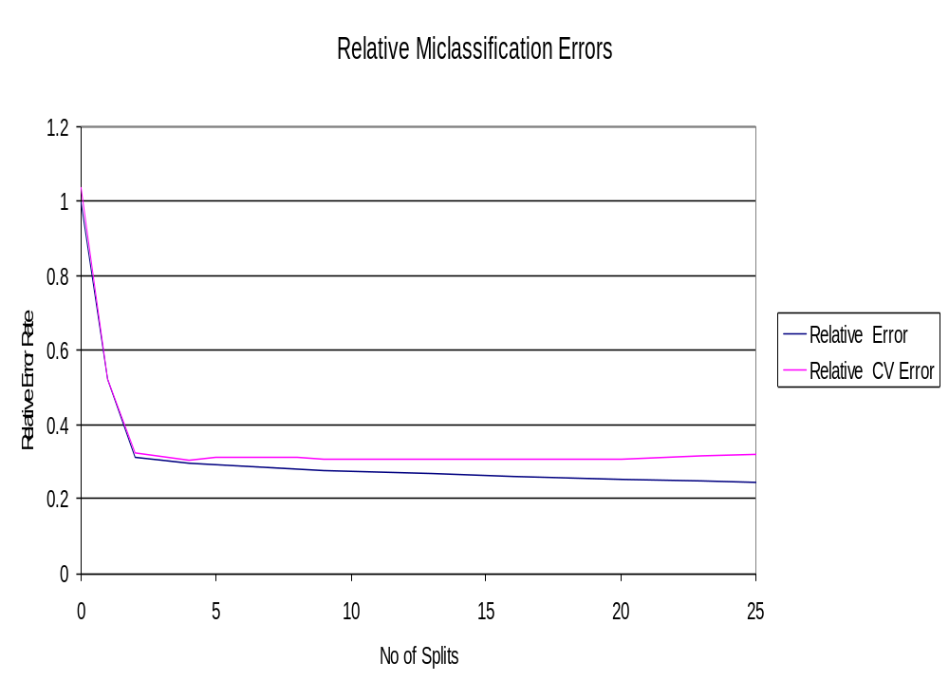
This relative CV error tends to be very flat which is why the “1-SE” Rule is preferred

Slide 37
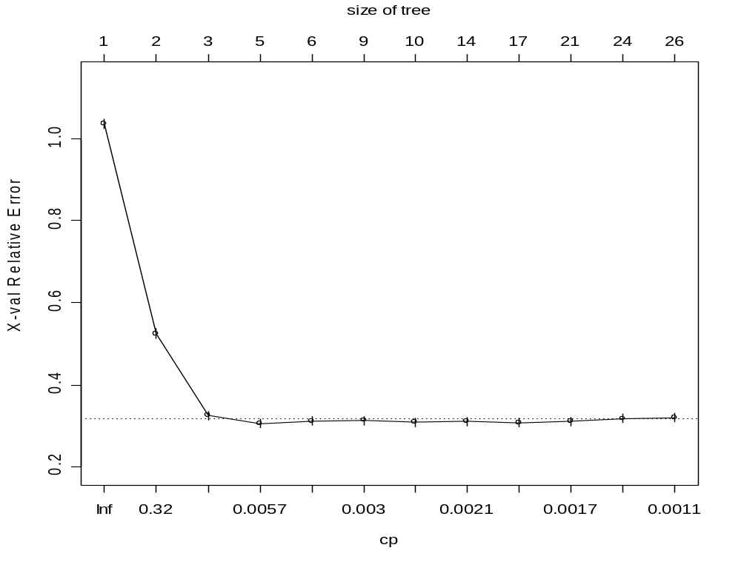

Slide 38
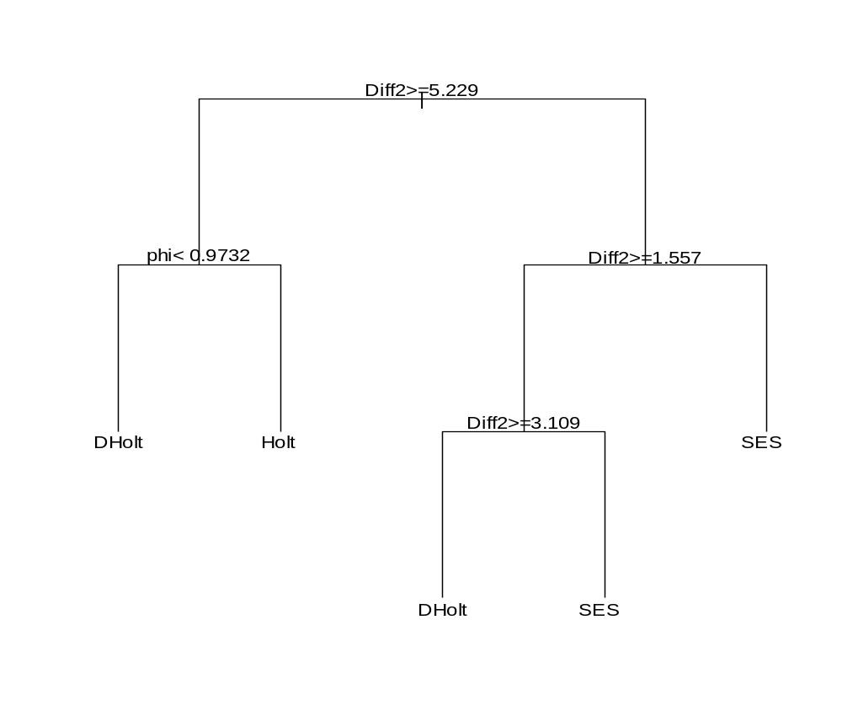
This suggests that a cp of 0.003 is about right for this tree - giving the tree shown

Slide 39
Cost complexity
Whilst we did not use misclassification rate to decide on where to split the tree we do use it in the pruning. The key term is the relative error (which is normalised to one for the top of the tree). The standard approach is to choose a value of α, and then to choose a tree to minimise
Rα =R+ αsize
where R is the number of misclassified points and the size of the tree is the number of end points. “cp” is α/R(root tree).

Slide 40
Regression trees
Trees can be used to model functions though each end point will result in the same predicted value, a constant for that end point. Thus regression trees are like classification trees except that the end pint will be a predicted function value rather than a predicted classification.

Slide 41
Measures used in fitting Regression Tree
Instead of using the Gini Index the impurity criterion is the sum of squares, so splits which cause the biggest reduction in the sum of squares will be selected.
In pruning the tree the measure used is the mean square error on the predictions made by the tree.

Slide 42
Regression Example
In an effort to understand how computer performance is related to a number of variables which describe the features of a PC the following data was collected: the size of the cache, the cycle time of the computer, the memory size and the number of channels (both the last two were not measured but minimum and maximum values obtained).

Slide 43
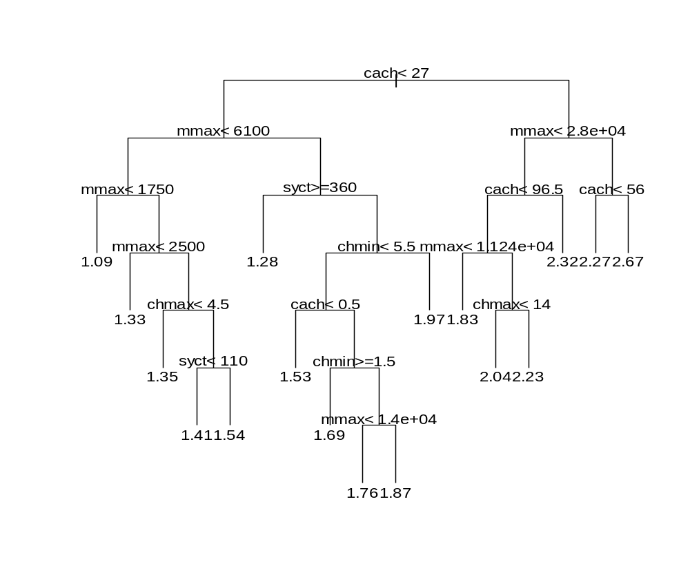
This gave the following tree:

Slide 44
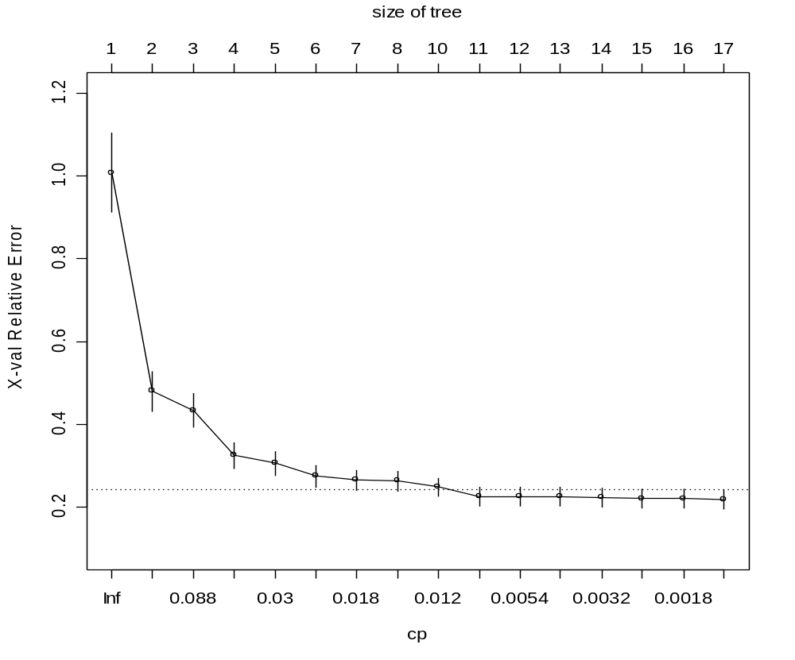
We can see that we need a cp value of about 0.008 - to give a tree with 11 leaves or terminal nodes

Slide 45
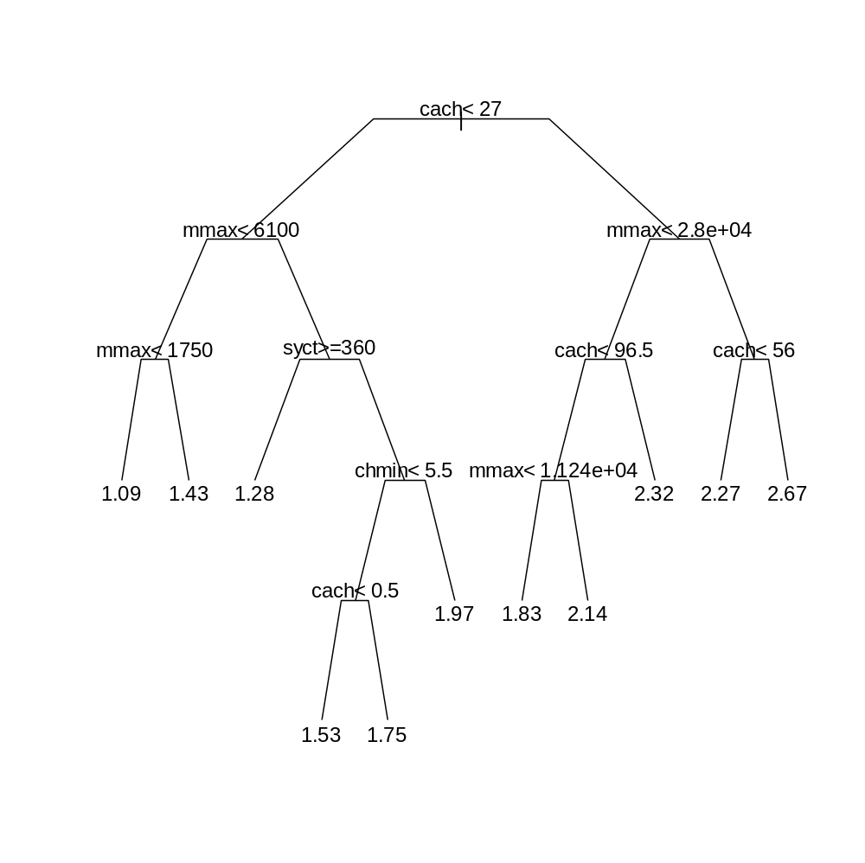
This enables us to see that, at the top end, it is the size of the cache and the amount of memory that determine performance

Slide 46
Advantages of CART
Can cope with any data structure or type
Classification has a simple form
Uses conditional information effectively
Invariant under transformations of the variables
Is robust with respect to outliers
Gives an estimate of the misclassification rate

Slide 47
Disadvantages of CART
CART does not use combinations of variables
Tree can be deceptive – if variable not included it could be as it was “masked” by another
Tree structures may be unstable – a change in the sample may give different trees
Tree is optimal at each split – it may not be globally optimal.

Slide 48
Exercises
Implement Gini Index on a spreadsheet
Have a go at the lecture examples using R and the script available on the web
Try classifying the Iris data using CART.

